Slide 1
SBAC Interim Assessment Hand Scoring Support
Edited January 25, 2016
Notes:
Local District NE is pleased to share these slides on how to access the tasks that you can use with teachers on the SBAC Performance Tasks. Remember that these materials are not secure, but not public, and all teachers have agreed to non-disclosure when they sign up to use the site. You make make limited copies of the materials for PD purposes. Tell Teachers: Do NOT post the materials on the web or share electronically. Thank you!

Slide 2
Reflecting on IAB
Hand Scoring Items
Training Guide
Provides information about the item
Scoring rubric
Exemplars
Prep Set
Student responses with scores and annotations
Check Set
Student responses without scores
Can be used to practice scoring
Includes answer key
Notes:
There are two main sets of materials that you will need to be aware of and have access to in order to hand score items from the interim assessments.
The first is the Training Guide. The Training Guide includes information about the item and the scoring rubric.
The second set of materials are called Exemplars.
Within the Exemplars are Prep sets and Check sets.
The Prep Sets include sample student responses with scoring comments. These are provided to help the scorer understand how the rubric and scored papers align.
The Check Sets include sample student responses without scoring comments. These are provided to help the scorer practice scoring using the rubric. Scores and scoring comments in the form of an Answer Key are available for all items in the Check Set.

Slide 3
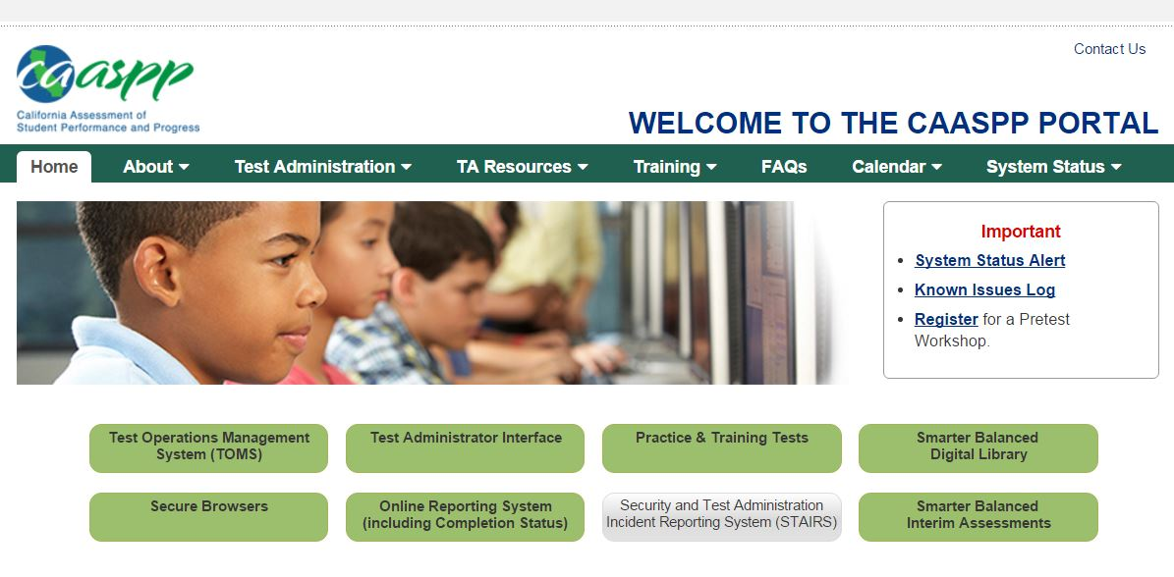
Reflecting on IAB
Hand Scoring Items
Notes:
Go to www.caaspp.org and click on Smarter Balanced Interim Assessments

Slide 4
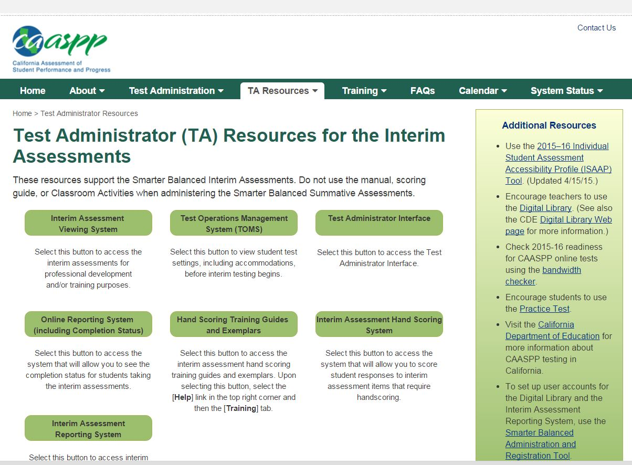
Reflecting on IAB
Hand Scoring Items
Notes:
Click on Hand Scoring and Training Guides and Exemplars

Slide 5
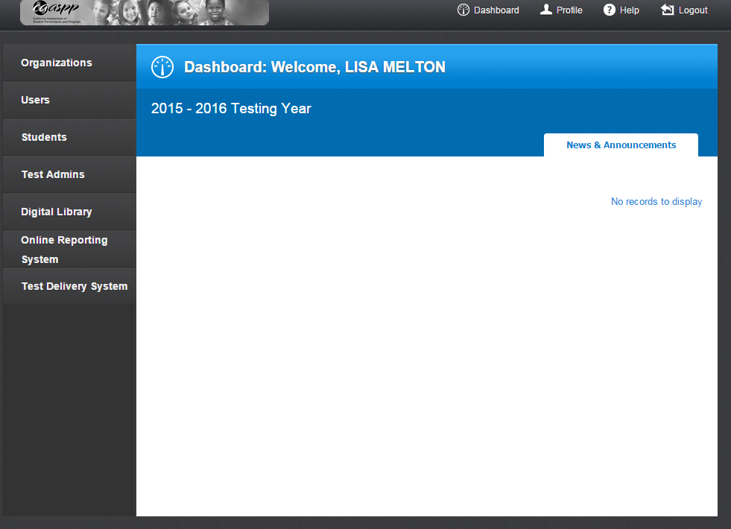
Reflecting on IAB
Hand Scoring Items
Notes:
Sign in with your TOMS account and then Click “Help”.

Slide 6
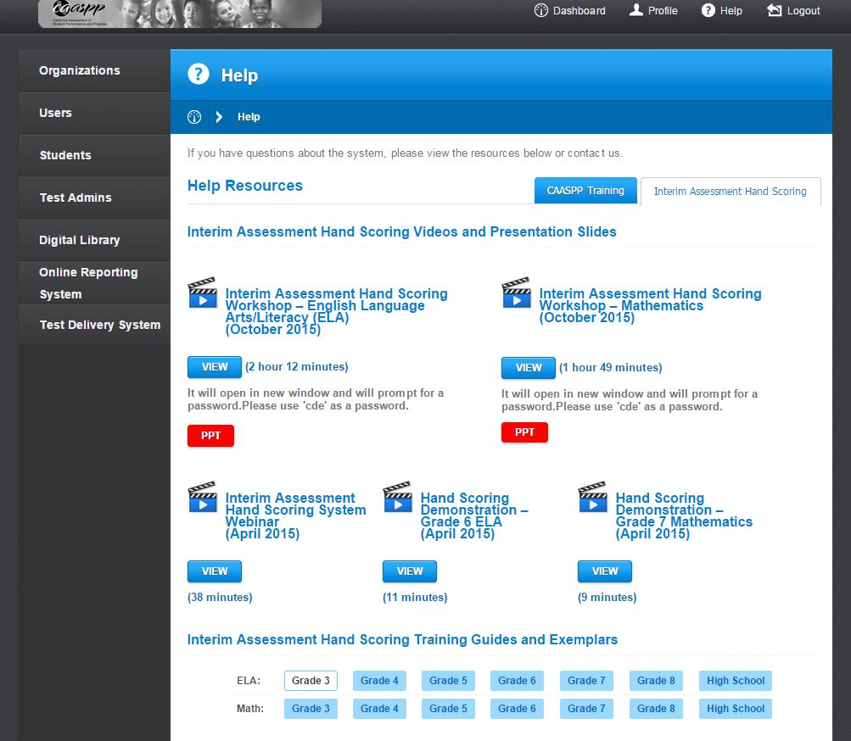
Reflecting on IAB
Hand Scoring Items
Notes:
Click “Interim Assessment Hand Scoring”

Slide 7
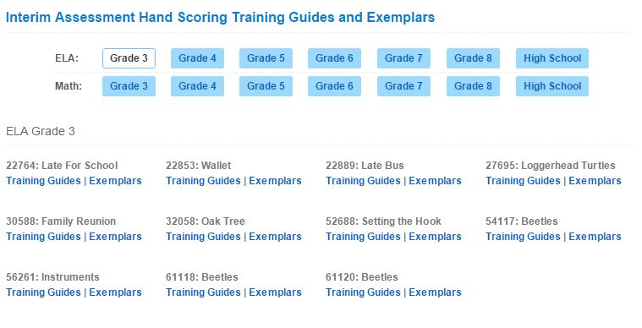
Reflecting on IAB
Hand Scoring Items
Notes:
Under ”Interim Assessment Hand Scoring Training Guides and Exemplars”, click the grade level by subject area. This is what it looks like for ELA.
Each item number corresponds to an individual item that needs hand scoring on the IAB.

Slide 8
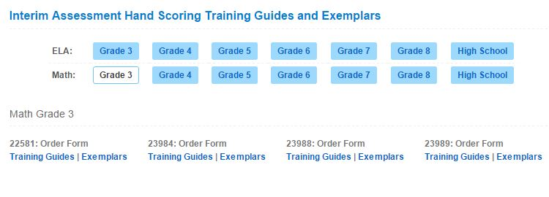
Reflecting on IAB
Hand Scoring Items
Notes:
Under ”Interim Assessment Hand Scoring Training Guides and Exemplars”, click the grade level by subject area. This is what it looks like for Math.
Each item number corresponds to an individual item that needs hand scoring on the IAB.

Slide 9
Resources
CDE’s Interim Assessments Web Page
http://www.cde.ca.gov/ta/tg/sa/sbacinterimassess.asp
Smarter Balanced Interim Assessments Web Page
http://www.smarterbalanced.org/interim-assessments/
Understanding the Smarter Balanced Interim Assessments
https://www.smarterbalancedlibrary.org/content/understandingmarter-balanced-interim-assessments
Using the Interim Assessment Blocks to Support Teaching and Learning
https://www.smarterbalancedlibrary.org/content/using-interim-assessment-blocks-support-teaching-and-learning
Notes:
Here are other sites for more information. Thank you!

